Slide 1
Ideas for Using sEMG signal

Slide 2
Fatigue Indicator (Virtual Trainer)
Superficial Muscles Fatigue Detector
Single Muscle Fatigue detector

Slide 3
Superficial Muscles Fatigue Detector
Need:
A trainer is required to build up muscles effectively
People can gain significant result if they can do exercise in a short time fatigue and avoid doing exercise while muscle gets fatigue
Objective:
To design and prototype a sensitive device that can help people maximize the benefit gaining from doing exercise by alerting people when any of targeted muscles are fatigue. The device should accurately alert what muscle get fatigue, show users what muscle is active while users doing exercise, be safe, easy to use and portable.

Slide 4
Requirement
Operation:
Wearable, portable and easy to use
Operation should not affect user’s activity
Functionality:
The device should accurately detect and alert users through their Iphone’s speaker when the targeted muscle get fatigue.
The device should show information about what muscles are active through their Iphone’s screen while users doing any activties
Usability:
No need for installation
Device will run automatically after turn on the switch

Slide 5
Energy:
Seperated ± 9V DC power supply for muscle sensor v3.
Adapter DC 12V/2A for DE2i-115 FPGA board.
Iphone battery.
Safety:
Device should not have any shape edges
Device should not cause any shock
Device should not too heavy to wear or carry
Legal:
Device must comply US pattern and copyright regulation
Documentation:
User’s operation and maintenance manual will be provided

Slide 6
Constraint:
We have to buy DE2i-115 board which costs $700 (if we don’t get into final list)
We have up until May 2016 to finish the product
None of us has experience with doing DSP on FPGA board
Super accurately detect fatigue index will be a challenge

Slide 7
Single Muscle Fatigue detector
Need:
A trainer is required to build up muscles effectively
People can gain significant result if they do exercise in a short time fatigue and avoid doing exercise while muscle gets fatigue
Objective:
To design and prototype a wearable device that can help people build up their biceps by providing users set of biceps exercises and alerting people when their biceps are fatigue. The device should provide effective biceps exercises and accurately alert biceps fatigue index, be safe, easy to use and portable.

Slide 8
Requirement
Operation:
Wearable, portable and easy to use
Operation should not affect user’s activity
Functionality:
The device should provide users appropriate set of exercises based on their selected mode.
The device should show the examples of how to do the exercises through their Iphone’s screen.
The device should check if users do exercises correctly
The device should accurately detect and alert users through their Iphone’s speaker when the targeted muscle get fatigue.
The device should show information about their activity through their Iphone’s screen.
Usability:
No need for installation
Device will run automatically after a mode is selected

Slide 9
Energy:
Seperated ± 9V DC power supply for muscle sensor v3.
Adapter DC 12V/2A for DE2i-115 FPGA board.
Iphone battery.
Safety:
Device should not have any shape edges
Device should not cause any shock
Device should not too heavy to wear or carry
Legal:
Device must comply US pattern and copyright regulation
Documentation:
User’s operation and maintenance manual will be provided

Slide 10
Constraint:
We have to buy DE2i-115 board which costs $700 (if we don’t get into final list)
We have up until May 2016 to finish the product
None of us has experience with doing DSP on FPGA board
Accurately detect fatigue index will be a challenge
Other device than sEMG should be used to check if users doing exercises correctly

Slide 11
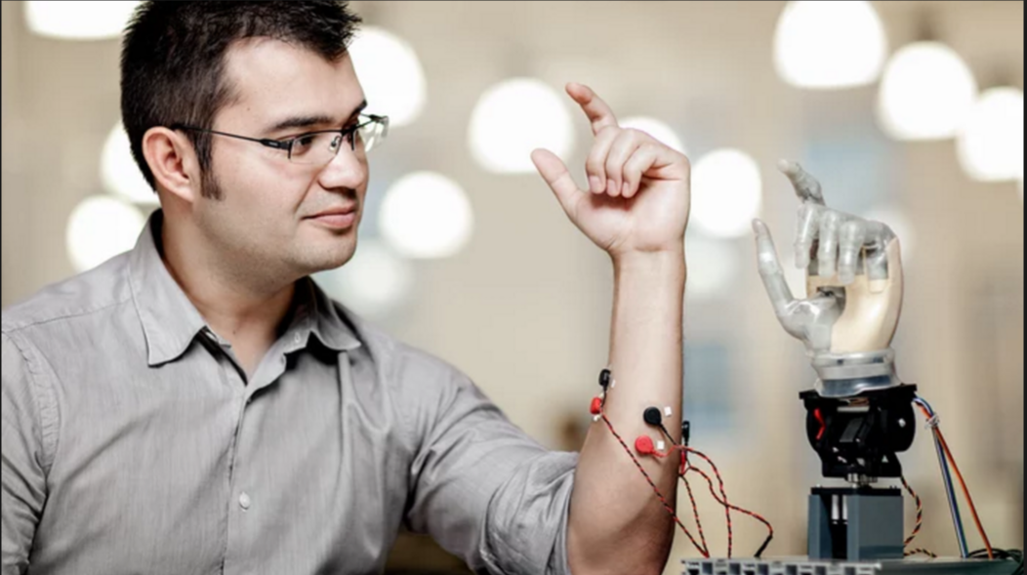
3D Printing Prosthetic Hand

Slide 12
Need:
Nearly 1 in 5 people have a disability in the U.S.
Prosthetic human’s part is expensive, not a one-time cost and need to be replaced after three to five years
Objective:
To design and prototype a sensitive 3D printing prosthetic hand that can mimic a real hand’s activities. The prosthetic hand will get the sEMG signal, analyze the signal and translate it into appropriate action. The prosthetic hand should not too heavy and can be easily attached to forearm.

Slide 13
Requirement
Operation:
Accurate, sensitive and quick
Operation should help disability people in their daily activities
Functionality:
The prosthetic hand should be able to mimic some basic real hand’s activities
The prosthetic hand’s activities will be controlled by sEMG signal coming from forearm.
Usability:
No need for installation
The prosthetic hand will function automatically after turn on the power

Slide 14
Energy:
Seperated ± 9V DC power supply for muscle sensor v3.
Adapter DC 12V/2A for DE2i-115 FPGA board.
Safety:
Device should not have any shape edges
Device should not cause any shock
Device should not too heavy to wear
Device should be waterproof
Legal:
Device must comply US pattern and copyright regulation
Documentation:
User’s operation and maintenance manual will be provided

Slide 15
Constraint:
We have to buy DE2i-115 board which costs $700 (if we don’t get into final list)
There is also cost for 3D printing parts for building the hand
We have up until May 2016 to finish the product
We have to do more signal analysis because sEMG for forearm has noise contamination and cross-talk signal.
Other sources can also be added to improve the accuracy.
Experience with doing DSP on FPGA board is needed
Knowledge in bio-mechanical field is needed

Slide 16
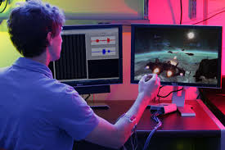
Computer Interaction

Slide 17
Need:
Nearly 1 in 5 people have a disability in the U.S.
It’s inappropriate for disability people to use computer
Prosthetic limb is expensive, not a one-time cost and need to be replaced after three to five years
Objective:
To design and prototype a device that can translate the sEMG signal to computer command. The device should accurately and quickly analyze the sEMG signal and translate it to the correct computer commands that the users want to perform.

Slide 18
Requirement
Operation:
Accurate, sensitive and quick
Operation should help disability people in their computer interaction
Functionality:
The device should provide accurate Windows’s command based on the provided sEMG signal.
The device will function based on sEMG signal coming from forearm.
Other sources can also be added to improve the accuracy.
Usability:
No need for installation
The device will function automatically after plug into the computer

Slide 19
Energy:
Seperated ± 9V DC power supply for muscle sensor v3.
Safety:
Device should not have any shape edges
Device should not cause any shock
Device should not cause any harmful activities for targeted computer
Legal:
Device must comply US pattern and copyright regulation
Documentation:
User’s operation and maintenance manual will be provided

Slide 20
Constraint:
We have to buy DE2i-115 board which costs $700 (if we don’t get into final list)
We have up until May 2016 to finish the product
We have to do more signal analysis because sEMG for forearm has noise contamination and cross-talk signal.
Experience with doing DSP on FPGA board is needed
Knowledge in Kernel and operating system is needed

Slide 21
QUESTIONS ?

